Slide 1
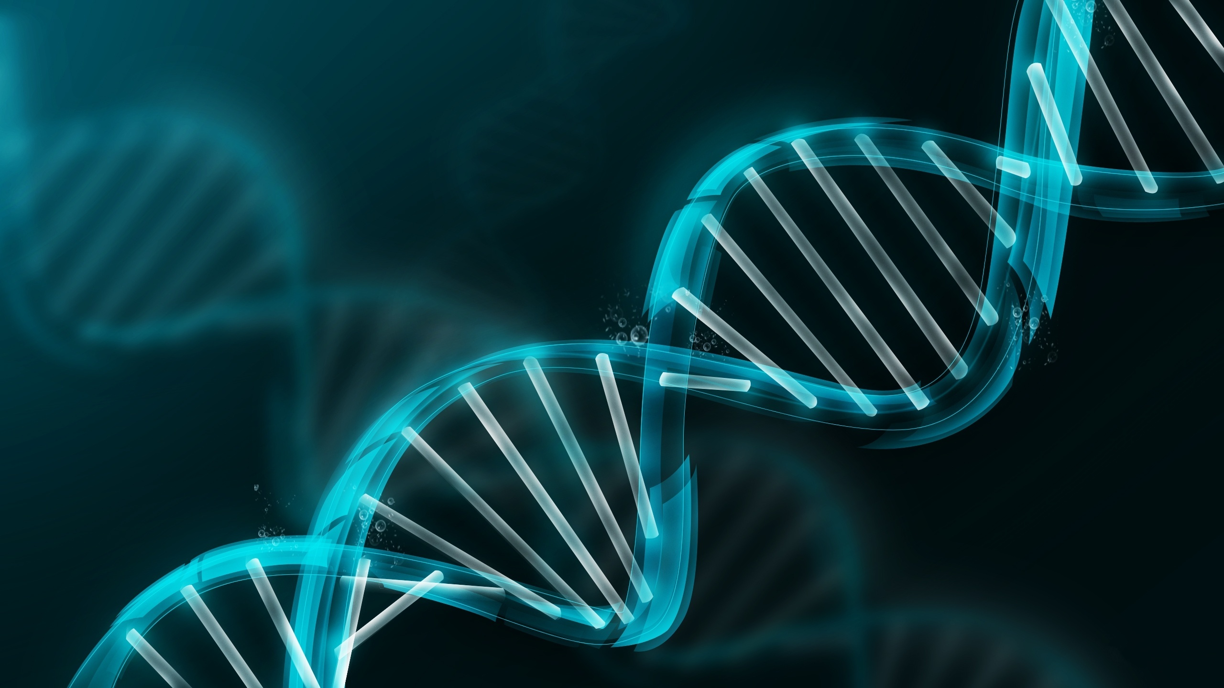
Prader Willi Syndrome & Necdin
By: Holly Heacock
Notes:
http://www.utahpeoplespost.com/wp-content/uploads/2014/05/DNA.jpg?width=400

Slide 2
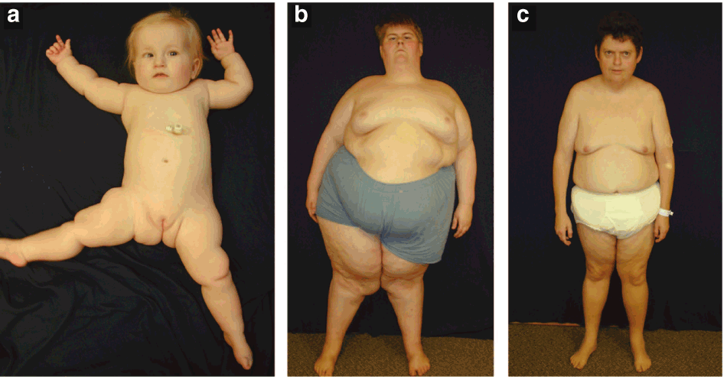
What is Prader Willi Syndrome?
Behavioral Disorder:
https://youtu.be/OB7tbp3rzv4?t=63
Notes:
http://www.aafp.org/afp/2005/0901/p827.html
http://www.pwcf.org/
http://www.scielo.br/scielo.php?script=sci_arttext&pid=S0004-282X2002000600024

Slide 3
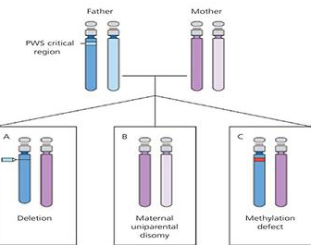
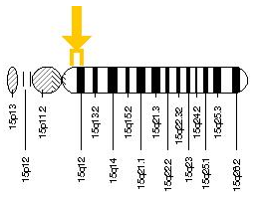
How is Necdin Involved?
Necdin is in the PWS critical region
Notes:
http://www.aafp.org/afp/2005/0901/p827.html
http://ghr.nlm.nih.gov/gene/NDN

Slide 4
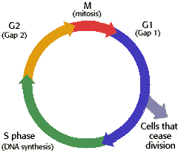
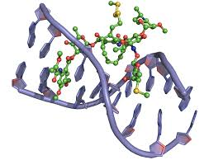
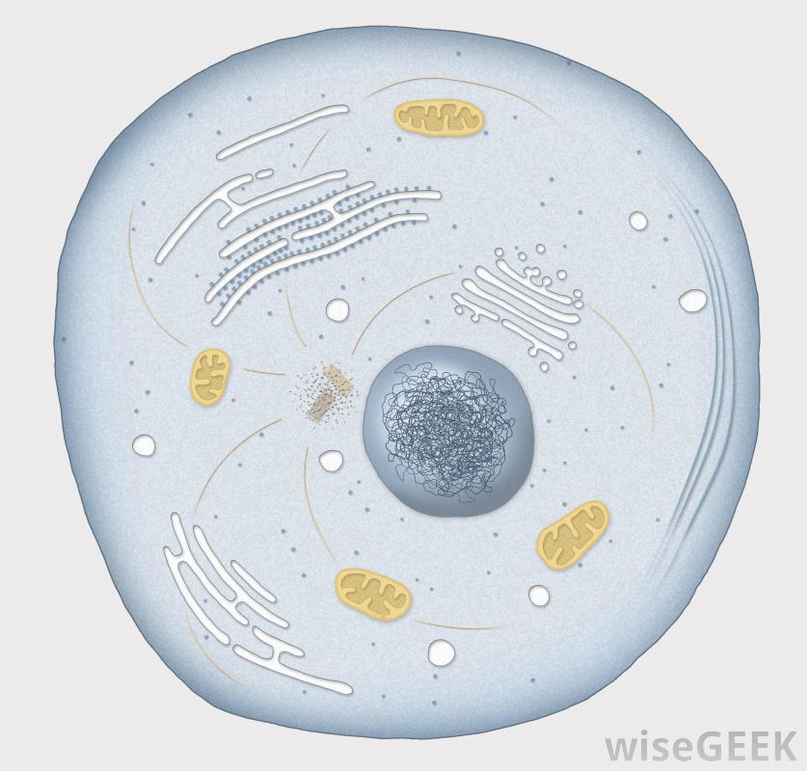
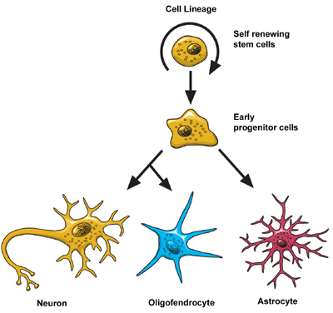
What does Necdin do and where?
Cellular Components
Biological Processes
Molecular Function
Cytoplasm
Cell Cycle Arrest
DNA Binding
Nucleus
Nerve Cell Differentiation
Notes:
http://www.atdbio.com/content/16/Nucleic-acid-drug-interactions
http://www.biology.arizona.edu/cell_bio/tutorials/cell_cycle/cells2.html
http://www.ninds.nih.gov/disorders/brain_basics/ninds_neuron.htm
http://www.wisegeek.org/what-is-the-cell-theory.htm

Slide 5
What is the structure of NDN?
MAGE
105-275
What is the MAGE Domain?

Slide 6
How well conserved is NDN?
321 aa
105-275
% Identity
321 aa
105-275
96%
325 aa
109-279
88%
325 aa
109-279
87%
325 aa
109-279
85%
325 aa
109-279
81%
Notes:
http://www.istockphoto.com/vector/cartoon-human-faces-25538478
http://www.shutterstock.com/s/monkey-eating/search.html
http://www.cafepress.com/+walrus-cartoon+drinking-glasses
http://cliparts.co/wolf-cartoon-pictures
http://free.clipartof.com/details/49-Free-Cartoon-Cow-Clip-Art
http://free.clipartof.com/details/57-Free-Cartoon-Gray-Field-Mouse-Clipart-Illustration

Slide 7
What is the Phylogeny of NDN?
Squirrel
Chimp
Human
Rhesus Macaque
Cow
Wolf
Walrus
Cat
Mouse

Slide 8
New Finding: Necdin’s role in muscle and fat differentiation
NDN
Notes:
http://www.ceritadinding.com/gaya-hidup/mitos-terkenal-akhirnya-terpecahkan/

Slide 9
Knowledge Gap: Does the loss of necdin cause a transition from loss of muscle cell formation to an increase of fat cell formation at a certain point in development?
NDN
Hypothesis: The loss of necdin regulates the transition from muscle cell differentiation to fat cell differentiation during development in Prader-Willi Syndrome individuals.
Notes:
http://www.ceritadinding.com/gaya-hidup/mitos-terkenal-akhirnya-terpecahkan/
http://galleryhip.com/life-stages-of-human-growth-and-development.html

Slide 10
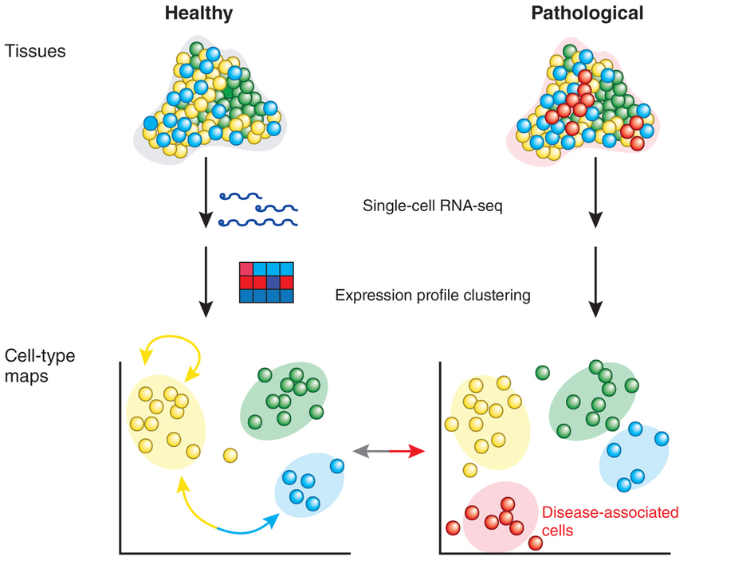
Aim 1: What is the expression of fat vs. muscle genes?
WT NDN
Loss of NDN
More Fat Regulatory Genes?
Hypothesis: Fat regulatory genes than muscle in mutant
Notes:
http://www.nature.com/nmeth/journal/v11/n1/fig_tab/nmeth.2764_F1.html

Slide 11
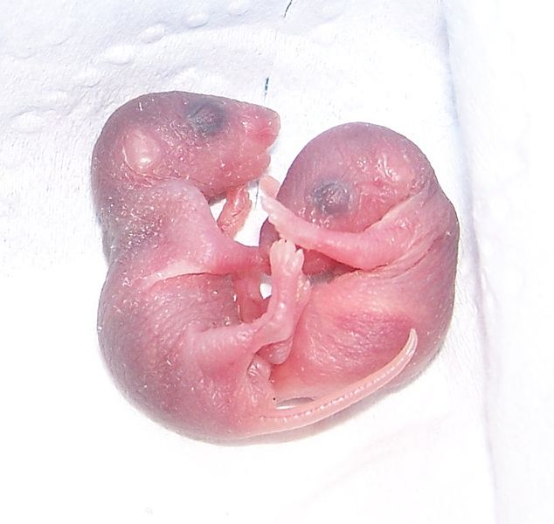
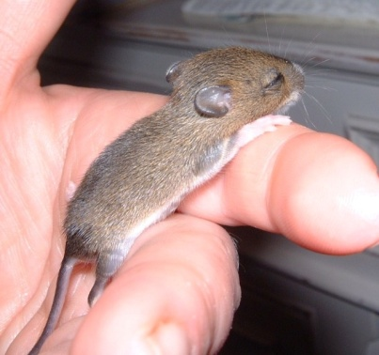
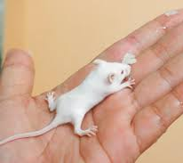
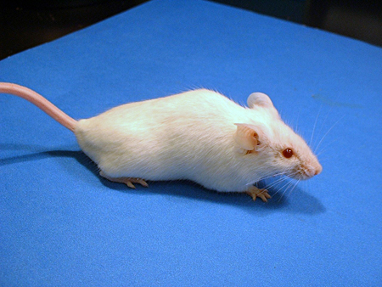
Aim 2: Does the loss of necdin contribute to muscle cell loss and fat cell accumulation at a certain stage in development?
WT NDN
LC-MS/MS
Loss of NDN
Hypothesis: Fat regulatory proteins during development in mutant
Notes:
http://www.nature.com/nrg/journal/v10/n9/pdf/nrg2633.pdf
http://www.critterbabies.com/baby-pets-and-farm-animals/baby-mouse/
http://www.gaystarnews.com/article/stem-cell-break-through-could-make-gay-couples-biological-parents081012
http://www.wikihow.com/Care-for-Baby-Mice
http://news.stanford.edu/news/2005/august24/mice-082405.html

Slide 12
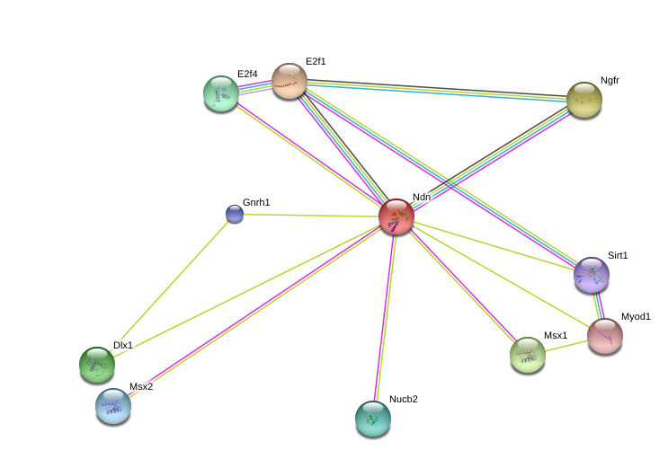
Aim 3: What are necdin interaction partners with fat and muscle cell regulatory proteins throughout development?
Step 1:
Cell Cycle Regulation
Future Directions
Muscle Cell Differentiation
Craniofacial Patterning
Calcium Binding
Hypothesis: Necdin will interact with many muscle cell regulatory proteins and fewer fat cell regulatory proteins, but new fat cell regulatory proteins will be found.
Notes:
String

Slide 13
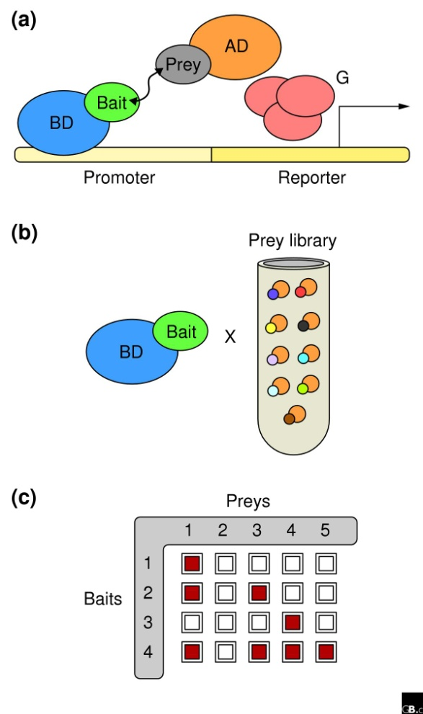
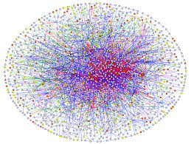
Aim 3: Step Two- Y2H Screening
Notes:
http://genomebiology.com/2005/6/3/210/figure/F2
String
http://www.hpcwire.com/2013/11/16/sc13-research-highlight-large-graph-processing-without-overhead/

Slide 14
Future Directions
Determine relationship between Ngfr, Necdin, and adipose differentiation
Create Diagnosis Plans using timeline information
Explore relationship of necdin in fat and muscle cell differentiation further
NDN
Ngfr
Notes:
http://www.ceritadinding.com/gaya-hidup/mitos-terkenal-akhirnya-terpecahkan/

Slide 15
Questions?

