Slide 1
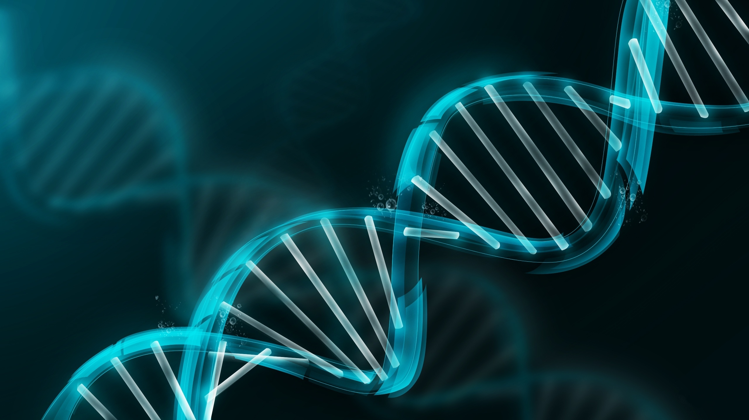
Prader Willi Syndrome & Necdin
By: Holly Heacock
Notes:
http://www.utahpeoplespost.com/wp-content/uploads/2014/05/DNA.jpg?width=400

Slide 2
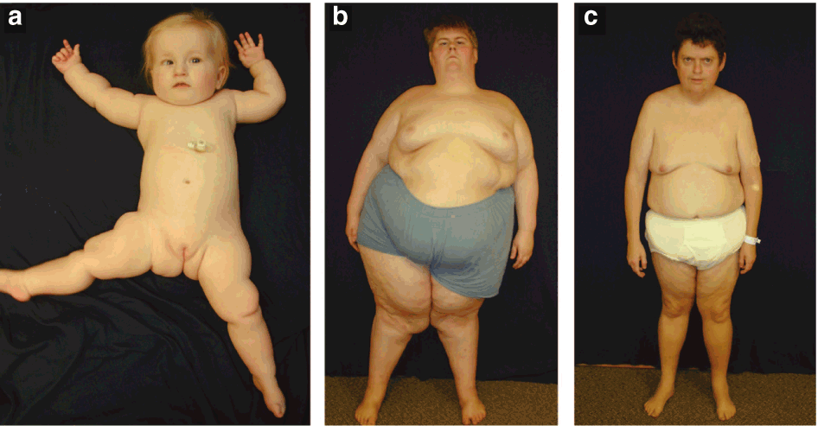
What is Prader Willi Syndrome?
Behavioral Disorder:
https://youtu.be/OB7tbp3rzv4?t=63
Notes:
http://www.aafp.org/afp/2005/0901/p827.html
http://www.pwcf.org/
http://www.scielo.br/scielo.php?script=sci_arttext&pid=S0004-282X2002000600024

Slide 3
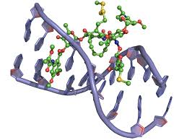
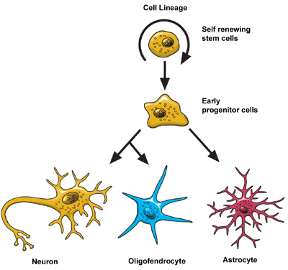
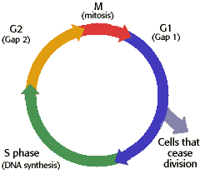
What does PWS affect?
DNA Binding
Nerve Cell Differentiation
Cell Cycle Arrest
Notes:
http://www.atdbio.com/content/16/Nucleic-acid-drug-interactions
http://www.biology.arizona.edu/cell_bio/tutorials/cell_cycle/cells2.html
http://www.ninds.nih.gov/disorders/brain_basics/ninds_neuron.htm

Slide 4
What is the structure of NDN?
MAGE
105-275
What is the MAGE Domain?

Slide 5
How well conserved is NDN?
321 aa
105-275
% Identity
321 aa
105-275
96%
325 aa
109-279
88%
325 aa
109-279
87%
325 aa
109-279
85%
325 aa
109-279
81%
Notes:
http://www.istockphoto.com/vector/cartoon-human-faces-25538478
http://www.shutterstock.com/s/monkey-eating/search.html
http://www.cafepress.com/+walrus-cartoon+drinking-glasses
http://cliparts.co/wolf-cartoon-pictures
http://free.clipartof.com/details/49-Free-Cartoon-Cow-Clip-Art
http://free.clipartof.com/details/57-Free-Cartoon-Gray-Field-Mouse-Clipart-Illustration

Slide 6
What is the Phylogeny of NDN?

Slide 7
What are NDN’s Go Terms?
Cellular Components
Biological Processes
Molecular Function
Cytosol
Perikaryon
Nucleus
CNS Development
Post-Embryonic Development
Regulation of Growth
Regulation of Transcription
DNA Binding
Notes:
http://www.atdbio.com/content/16/Nucleic-acid-drug-interactions

Slide 8
Could Rhesus Macaques be a better model organism for PWS?
Mouse NDN Expression:
Brain
Cytoplasm
Human NDN Expression: Ubiquitous
Perikaryon
Notes:
NDN expression differences- both in different cells and intracellularly

Slide 9
Hypothesis
Rhesus macaque NDN will have more similar sequences and expression patterns to humans than to mice because of its closer evolutionary split and sequence homology.

Slide 10
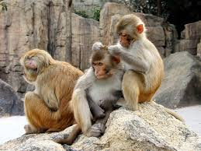
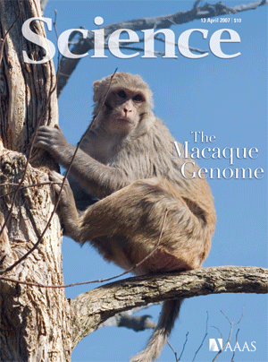
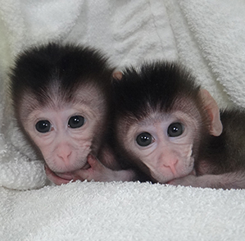
Why use the Rhesus Macaque?
Easy upkeep in captivity
Closely related to humans
Has been used in past studies of genetic imprinting
Genome finished in 2007
2nd nonhuman primate
Notes:
http://www.patentdocs.org/2007/04/
http://www.technologyreview.com/news/523986/monkeys-modified-with-genome-editing
http://www.redorbit.com/education/reference_library/animal_kingdom/mammalia/2577882/rhesus_macaque

Slide 11
Specific Aim 1: Determine sequence similarities and differences of human, mice, and rhesus macaque NDN
Organism | Coverage | Percent Identity
Rhesus macaque | 58% | 96%
Mouse | 50% | 81%
Approach: Use BLAST to align and determine sequence similarities and differences
Hypothesis: Humans will have a higher percentage identity to rhesus macaques than to mice.

Slide 12
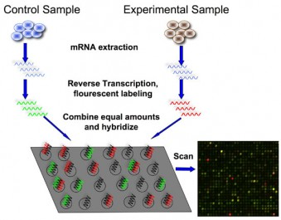
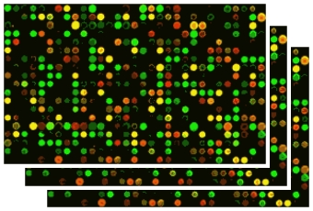
Specific Aim 2: Determine NDN gene expression changes in different tissues of the rhesus macaque compared to humans and mice.
Approach: Use microarray to uncover gene expression levels in different tissues.
Hypothesis: Humans will have more similar expression levels of necdin RNA to rhesus macaques than to mice.
Notes:
http://bitesizebio.com/7206/introduction-to-dna-microarrays/
http://www.fastol.com/~renkwitz/microarray_chips.htm

Slide 13
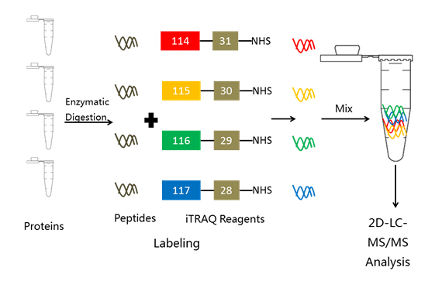
Special Aim 3 : Determine NDN protein expression tissue locations in rhesus macaques compared to mice and humans
Brain
Kidney
Brain
Kidney
MS/MS Analysis
Approach: Use iTraq labeling and mass spectrometry to establish presence and relative abundance of necdin protein in different tissues within each organism.
Hypothesis: Rhesus macaques will have necdin protein within all tissues of the body while mice will only have expression in brain tissue.
Notes:
http://www.creative-proteomics.com/Services/iTRAQ-based-proteomics-analysis.htm

Slide 14
Future Directions
Use Rhesus Macaques as a model organism for PWS studies
Create NDN knockout animal
Analyze protein expression both in neural tissue and other tissues
Determine further functions of necdin in primates

Slide 15
Questions?

